Slide 1
Database Website for AP
The purpose of the website is to collect data about the volunteers. the website is not open for public use.

Slide 2

Landing Page

Slide 3

Login

Slide 4
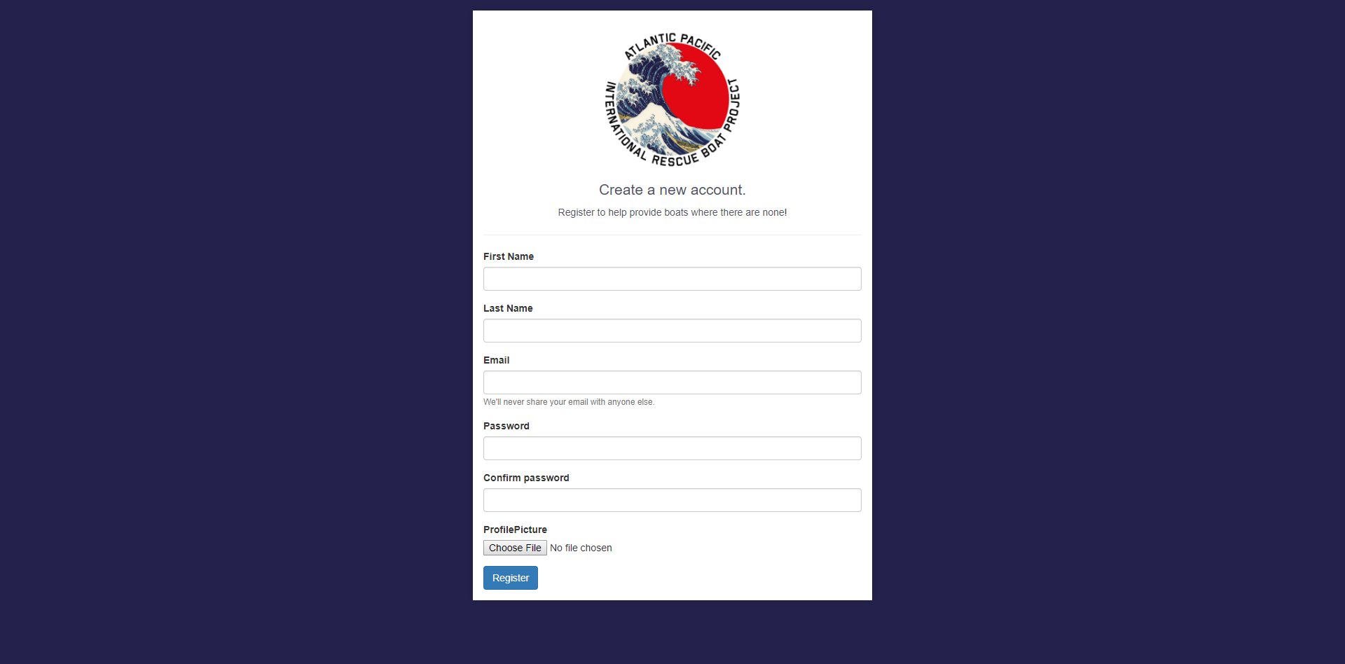
Register

Slide 5
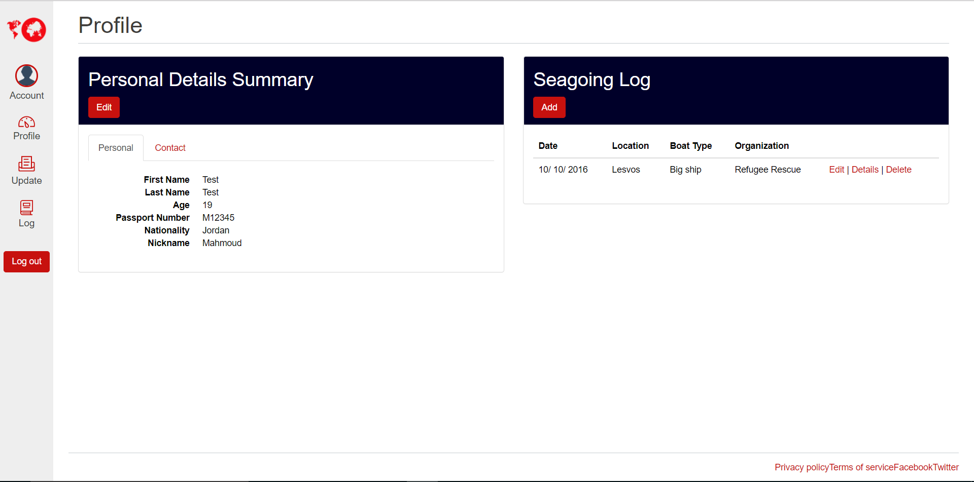
Profile

Slide 6
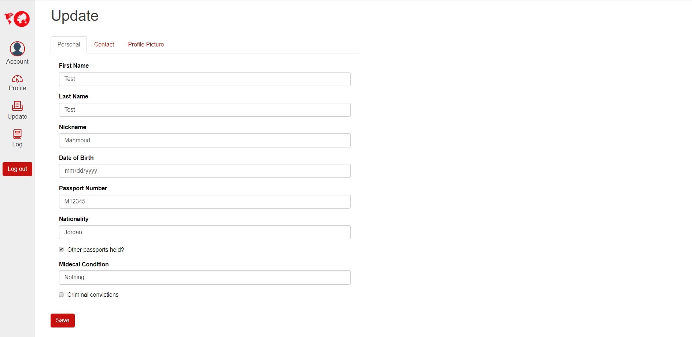
Update Details

Slide 7
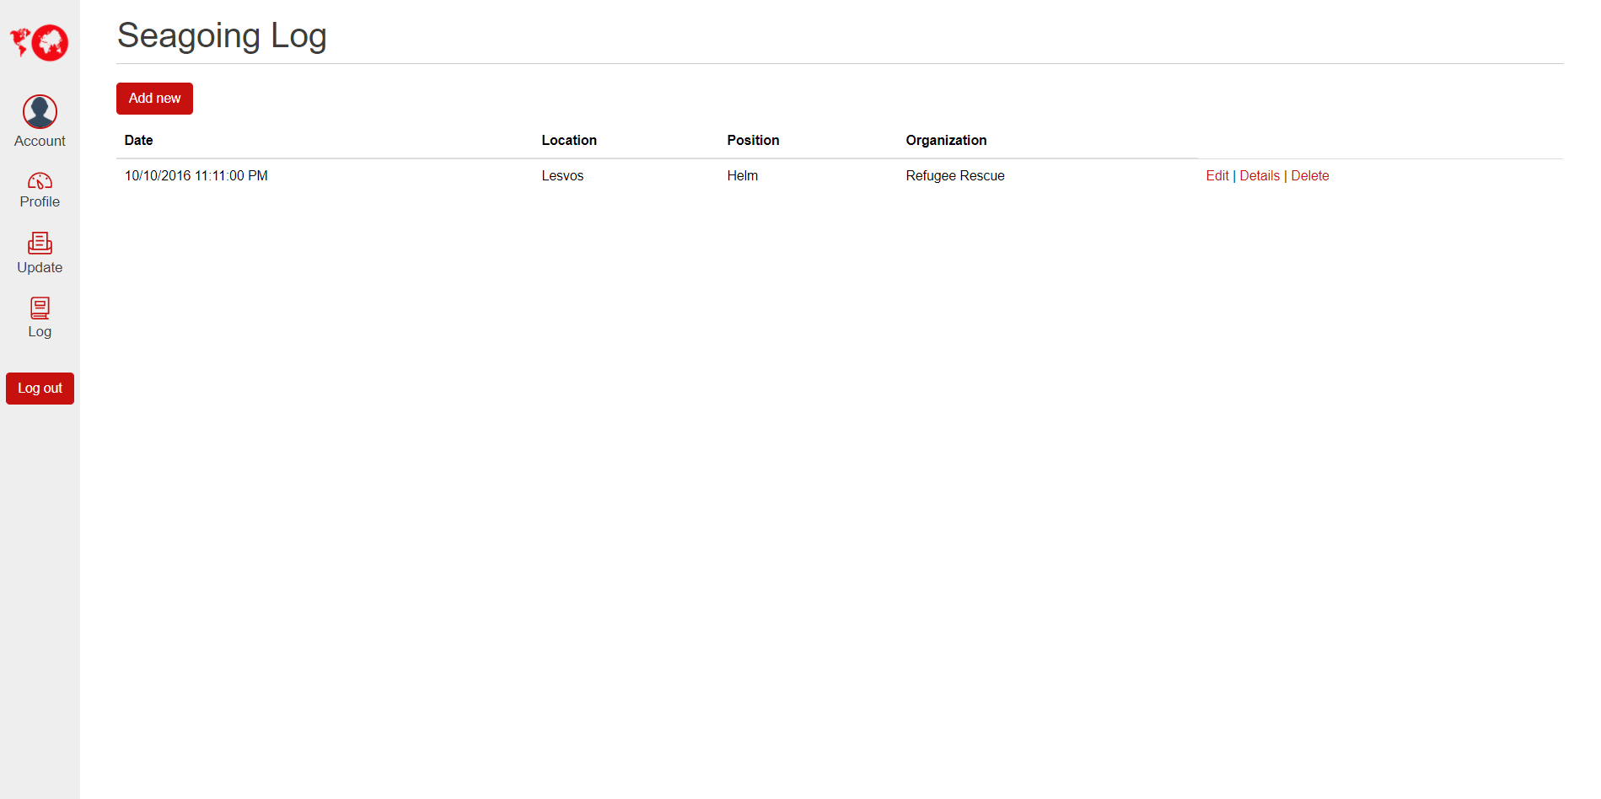
Seagoing Log

